Slide 1
《英语国家社会与文化入门》(下册）
The Society and Culture
of Major English-Speaking Countries
An Introduction
(Book Two)

Slide 2
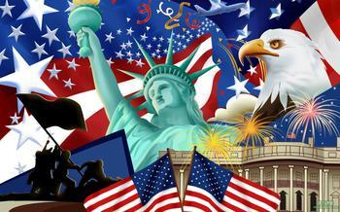
The United States of America
Unit 12 The Women’s Liberation Movement in America

Slide 3
Quiz
Give the English and a brief explanation for the following:
1 美国妇女运动第一浪潮
2 《女性的奥秘》
3 “全国妇女组织”
4 女权主义（女性主义）
5 “玻璃天花板”

Slide 4
Focal Points
the first wave of the American Women’s Movement
Seneca Fall convention in 1848 and the Seneca Fall Declaration
Lucretia Mott
Elizabeth Cady Stanton
improvements in the conditions of women’s lives in the 20th century
the second wave of the American Women’s Movement
Betty Friedan and The Feminine Mystique
NOW
the backlash against feminism
current status of American women

Slide 5
This Unit Is Divided into Five Sections
The First Wave of the American Women’s Movement
An Overall Improvement in the Conditions of Women’s Lives
The Second Wave of the American Women’s Movement
The Backlash against Feminism
The Current Status of Women

Slide 6
I. The First Wave of the American Women’s Movement
In the 1840s, the American feminists saw the connection between women’s position and that of the black slaves:
-The two groups were both described as inferior, and therefore needing mastery;
-They were often described as childlike, and therefore needing control;
-They were regarded as without intelligence, and therefore not to be trusted to vote or to exercise judgment in public affair;
-They were basically unthinking and thus inferior creatures, they were actually happier under the domination of masters.

Slide 7
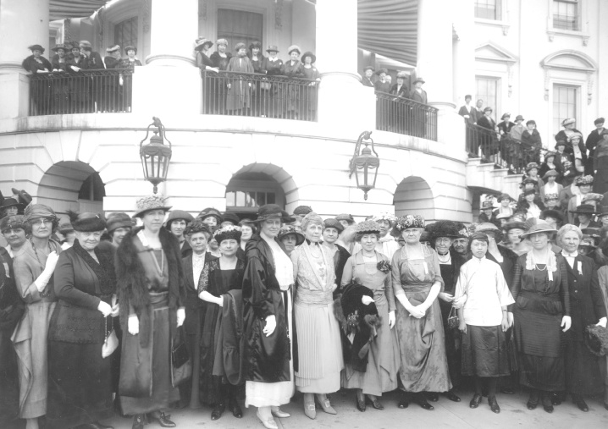
I. The First Wave of the American Women’s Movement
The Seneca Falls Convention:
A meeting was held to consider the “social, civil, and religious condition and rights of women in Seneca Falls in upstate New York in 1848.

Slide 8
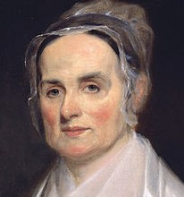
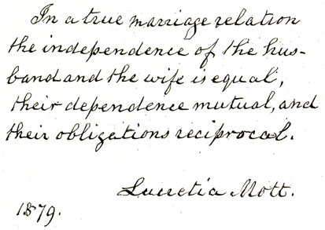
I. The First Wave of the American Women’s Movement
The key-note speaker at the meeting was Lucretia Mott (1793-1880).
Lucretia Mott was an American Quaker, abolitionist, a women‘s rights activist, and a social reformer.

Slide 9
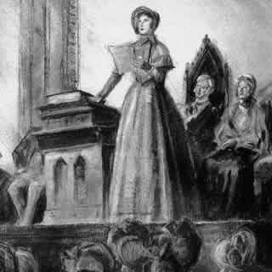
I. The First Wave of the American Women’s Movement
Elizabeth Cady Stanton (1815-1902) also played an important role at the convention. She was an American social activist, abolitionist and leading figure of the early women’s rights movement. The Declaration of Sentiments she presented at the Seneca Falls Convention is often credited with initiating the first organized women's rights and women’s suffrage movements in the United States.

Slide 10
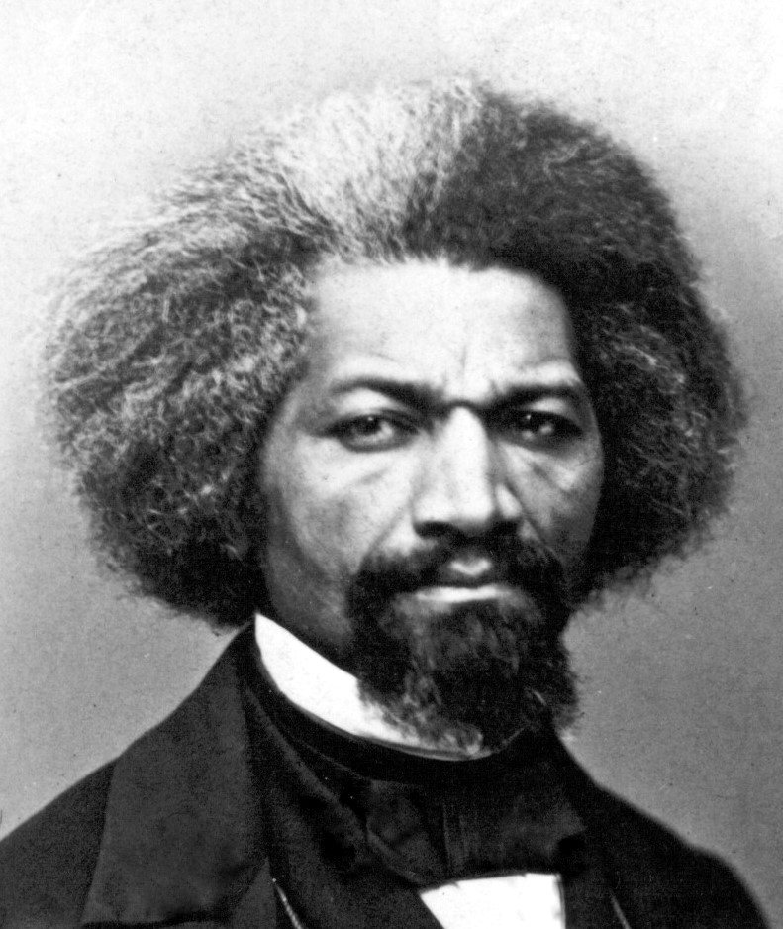
I. The First Wave of the American Women’s Movement
Frederick Douglass (1818-1895) was present at the convention. Born into slavery, Douglass had taught himself to read and write, and now the editor of a weekly abolitionist paper, The North Star, and champion of full political rights for women, he stoutly defended a document drafted and read at the convention, The Seneca Falls Declaration.

Slide 11
I. The First Wave of the American Women’s Movement
The Seneca Falls Declaration is now regarded as the single most important document of the nineteenth-century American woman’s movement. Using the Declaration of Independence as a model, it marks the first call for systematic rights for women along the lines of those already available to white men. The Declaration states:
We hold these truths to be self-evident: that all men and women are created equal; that they are endowed by their Creator with certain inalienable rights; that among these are life, liberty, and the pursuit of happiness; that to secure these rights governments are instituted, deriving their just powers from the consent of the governed.

Slide 12
II. An Overall Improvement in the Conditions of Women’s Lives
Women’s lives improved in the 20th century:
First, in terms of technology, factories had now taken over many of the traditional tasks of women. Clothes were no longer made at home. Labor-saving devices such as washing machines and refrigerators, electric stoves and vacuum cleaners made housework less of a chore. Compulsory schooling took young children out of the home, where traditionally women had overseen their early education.
Second, American women were becoming more educated. By the 1950s, an increasing number of middle- and upper-middle class women expected to attend college. Medical and legal professions were beginning to open up to talented women, though it was strictly on a limited quota basis.
Finally, since the 1900s, white middle-class women were living longer and having fewer children. With the invention of the contraceptive pill, for the first time in history, women had reliable control over their fertility.

Slide 13
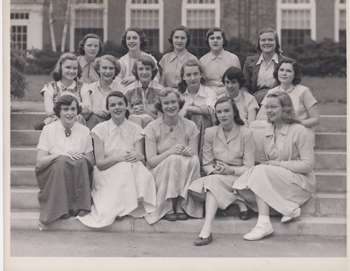
College women in the 1950s

Slide 14
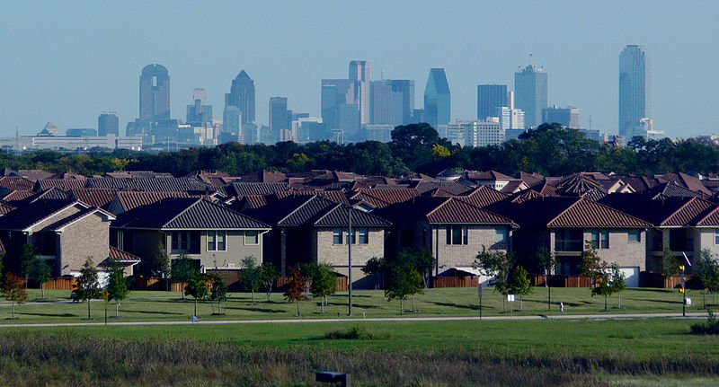
II. An Overall Improvement in the Conditions of Women’s Lives
The middle-class women were well educated, but they were often told that there were no jobs for them. They felt lonely and bored in their homes in the suburbs as full-time wives and mothers.

Slide 15
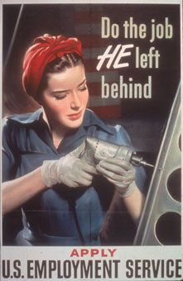
Dissatisfaction grew among women
However, these women’s mother generation had seen a different world. They had jobs in factories left behind by men who had gone to fight in war. Posters of women doing men’s jobs were displayed everywhere.

Slide 16
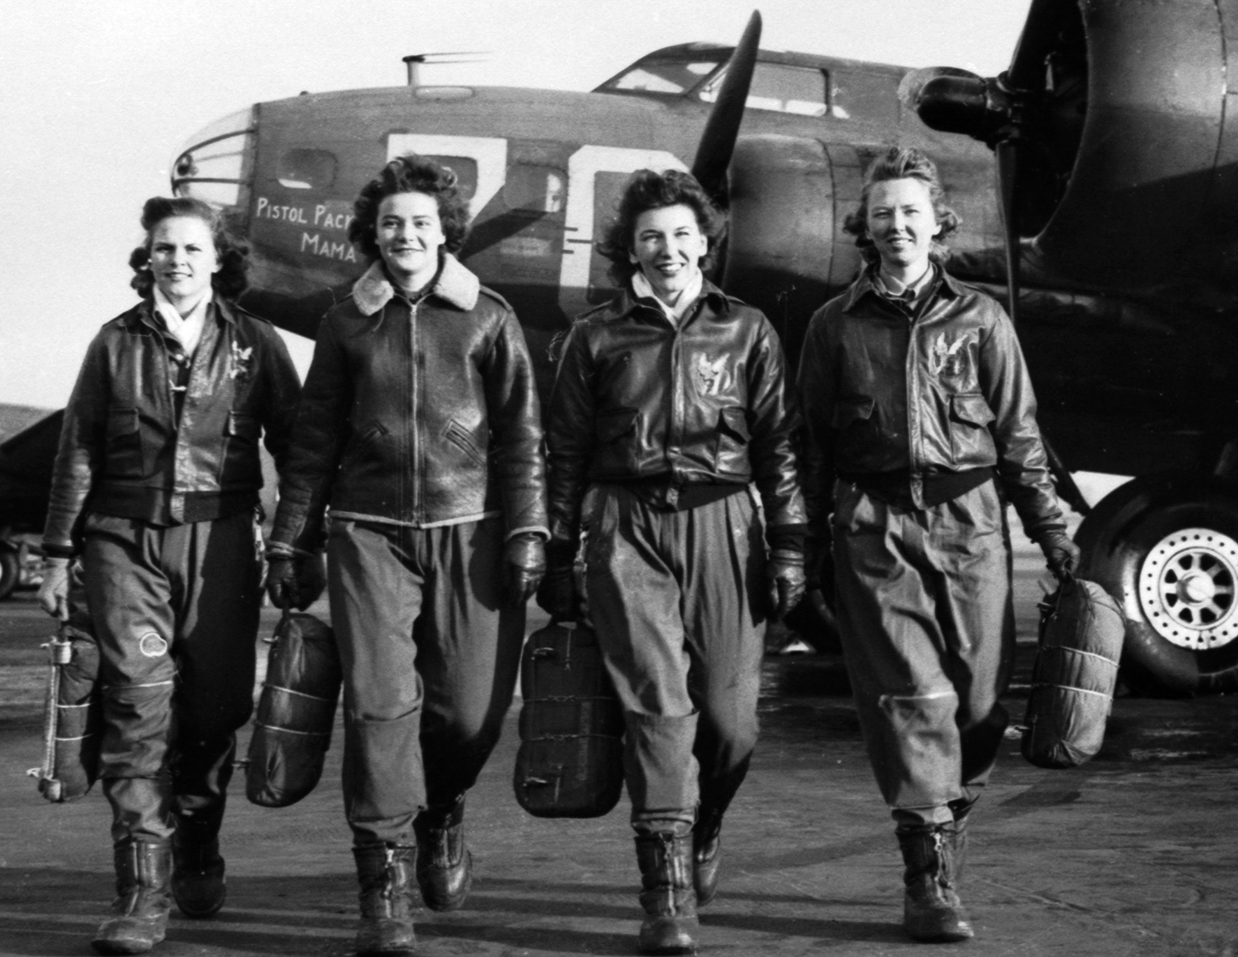
Dissatisfaction grew among women
During WWII, some women were able to participate in making parts of tanks or even fly planes. Now the daughters or younger sisters of these very same women were confined to their homes.

Slide 17
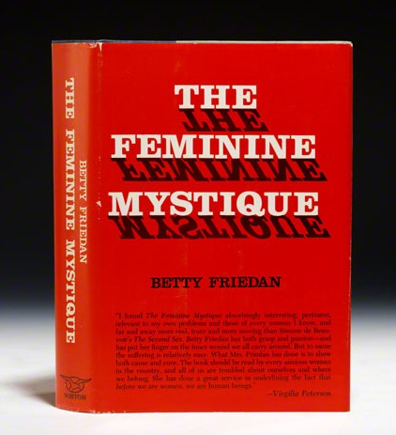
III. The Second Wave of the American Women’s Movement
The beginning of the second wave of the American women’s movement:
Betty Friedan (1921-2006), a journalist, was sent out by her magazine to interview fellow classmates, graduates of a leading women’s college, and she was astonished these women were unhappy. Friedan wrote about their problems in her landmark book, The Feminine Mystique, published in 1963, which is often credited with sparking the second wave of American feminism in the 20th century.

Slide 18
III. The Second Wave of the American Women’s Movement
The connection between the Civil Rights Movement and the women’s movement:
Once again, the feminists found common cause with the new campaign for black equality. The educated white women adopted many of the same strategies as the new civil rights movement in obtaining their ends. Learning from the tactics of the great black leader, Martin Luther King, Jr., feminists held peaceful demonstrations and sit-ins, initiated letter campaigns to their politicians, organized voting drives, and sought to change existing legislation regarding women through the courts.

Slide 19
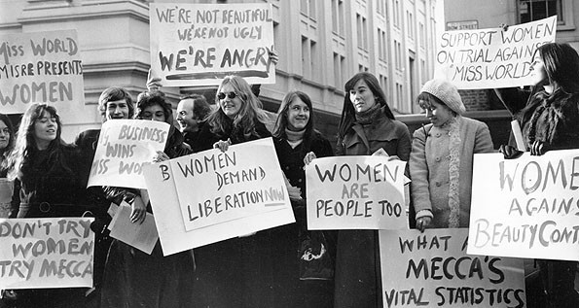
III. The Second Wave of the American Women’s Movement
A women’s demonstration in the 1960s. One poster read: “We are not beautiful. We are not ugly. We are angry!”

Slide 20
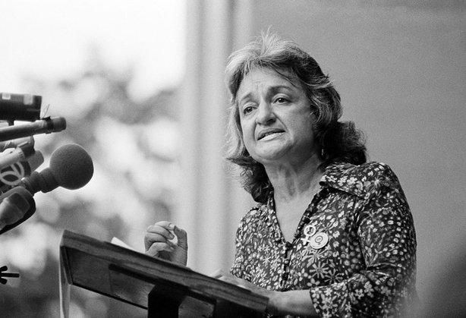
National Organization for Women (NOW)
The National Organization for Women (NOW) is the largest organization of feminist activists in the United States. NOW has hundreds of thousands of contributing members and more than 500 local and campus affiliates in all 50 states and the District of Columbia. Since its founding in 1966, NOW’s goal has been “to take action” to bring about equality for all women.
Betty Friedan, co-founder of NOW spoke at a meeting in 1970.

Slide 21
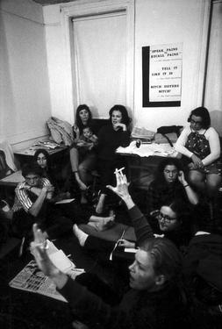
“Consciousness-raising” groups
“Consciousness-raising” groups were organized by younger and more radical women in every community in which they were active. These groups sought to bind women together in a new ideological vision of how their lives could be remade outside of traditional gender roles. (Right: a consciousness-raising session in 1969)

Slide 22
IV. The Backlash against Feminism
In mid 1970s, some survey shows that as more women were employed and involved in feminist activism, divorce rate went up and the fertility rate went down. Feminists were blamed for all this.
By the time of the 1980 election of the Republican president, Ronald Reagan, the backlash against feminism was in full swing.

Slide 23
IV. The Backlash against Feminism
“Promise-Keepers”:
“Promise-Keepers” is a religiously conservative organization.
The movement teaches that men should be fathers and providers as well as the heads of their families.
They regard American society as in moral crisis in part because men have abandoned their responsibilities and in part because women, influenced by feminism, have taken on men’s roles.
They consider that women should be at home, bearing children and caring for them and acting as supports for their husbands.
In their view, the entire Women’s Liberation Movement was a drastic mistake and has led to the potential disintegration of American society.

Slide 24
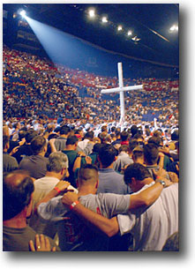
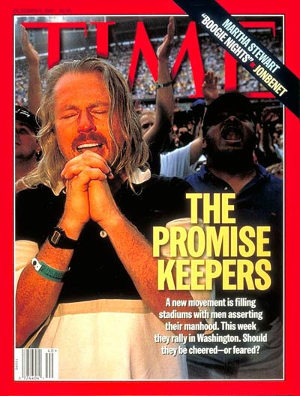
“Promise Keepers” asserting their manhood

Slide 25
V. The Current Status of Women
Progress in women’s status:
-Women’s gains in educational attainment have significantly outpaced those of men over the last 40 years. Today, younger women are more likely to graduate from college than are men and are more likely to hold a graduate school degree. Higher percentages of women than men have at least a high school education, and higher percentages of women than men participate in adult education.
-The participation of women in the workforce rose dramatically through the mid-1990s. More and more women are the primary breadwinner in their household (almost 40%) or are providing essential income for the family's bottom line. Their buying power has never been greater.
- More women are involved in the leadership of the country’s political and economic life.

Slide 26

Women in Education
Women earn almost 60 percent of undergraduate degrees, and 60 percent of all master’s degrees.

Slide 27
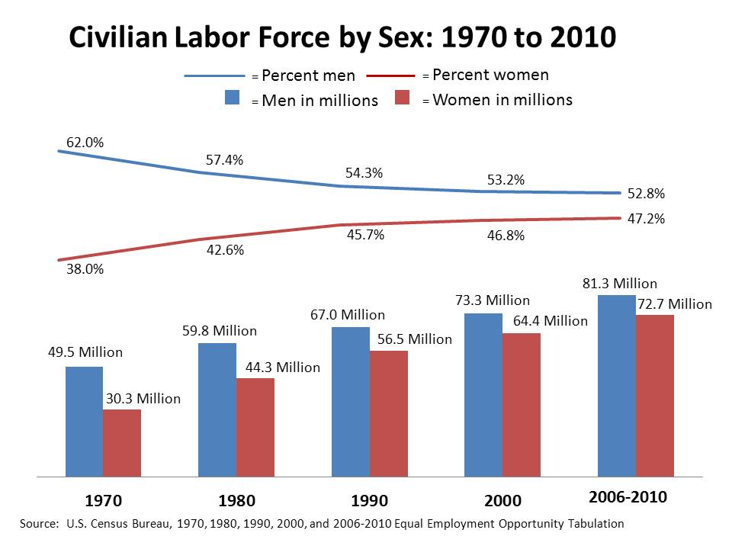
Women in Workforce

Slide 28
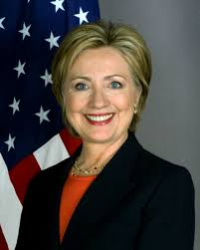
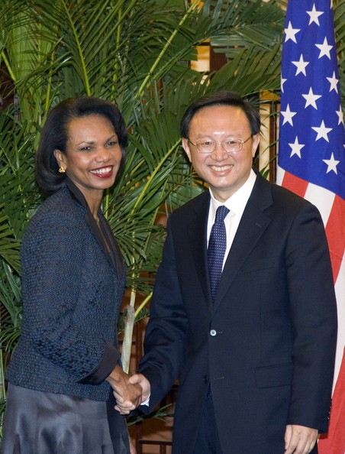
Women in Political Leadership
Hilary Clinton, former U.S. Sectary of State, U.S. Senator and First Lady of the U.S. A.
Condoleezza Rice, the 66th U.S. Secretary of State

Slide 29

Women in Business
American women account for 14.6 percent of executive officers, 8.1 percent of top earners, and 4.6 percent of Fortune 500 CEOs.

Slide 30
V. The Current Status of Women
Some problems in women’s status:
- Despite their gains in labor market experience and in education, women still earn less than men;
-Women continue to spend more of their time in household activities or caring for other family members;
- Women now often come up against what is known as the “glass ceiling” – a barrier to promotions within their chosen careers;
- Women and men work in different occupations, with women still concentrated in lower-paying and traditionally female occupations;
- Women are about 10% of civil engineers and a third of physicians and surgeons but 98% of kindergarten teachers and dental assistants;
-Most CEOs of American companies (98%) are still men, and there are not enough women High or Supreme Court judges or leading professionals or politicians.

Slide 31
V. The Current Status of Women
How does the American women’s status measure up to that in European countries?
-American women are now distinctly disadvantaged in comparison to their European counterparts. While the European Union has mandated paid maternity (and now parental) leave, women in America have no such automatic right;
- In the public sector—and in the percentage of female legislators in particular—American women lag far behind many European countries: 18 percent of the U.S. House representatives are women while the percentages of female legislators in Finland, Iceland, and Norway are 43, 40, and 40 respectively, in 2012.

Slide 32
Questions for Discussion
A. How were both Negroes and women marginalized by the American mainstream society in the 19th century?
B. How did the first wave of the Women’s Liberation Movement begin?
C. Why were American women unhappy although their conditions were generally improved in the 1950s?
D. How was the second wave of the Women’s Liberation Movement related with Civil Rights Movement in the 1960s?
E. What is the current status of women in America today?

Slide 33
The End
高等教育出版社
2015

